Slide 1
Introduction to HTML
Tags and Attributes

Slide 2
What is HTML?
HTML: HyperText Markup Language,
Language used to create Web pages
Using HTML, you can create a Web page with
Text
Graphics
Sound
video

Slide 3
HTML
Tim Berners-Lee created first HTML version in the late 1980s

Slide 4
HTML forms
A Form is an area that can contain Form Control/ Elements.
Each piece of information for a form is stored in a Field.
The value itself is called Field Value.
Users enter or select a field using Form
Control/ Elements.
Form/Control elements include: buttons, checkboxes, text fields, radio buttons, drop-down menus, etc.
A form usually contains a Submit button to send the information in the form elements to the server.

Slide 5
Control Elements of HTML Form
Input Boxes – for text and numerical entries
Option Buttons, also called Radio Buttons – for selecting a single option from a predefined list
Selection Lists – for long lists of options, usually appearing in a Drop-Down List Box
Check Boxes – for specifying yes or no
Text Areas – for extended entries that can include several lines of text

Slide 6
HTML Form
The basic construction of a HTML form is this...
<form> - begin a form <input> - ask for information in one of several different ways <input> - there can be as many input areas as you wish </form> - end a form HTML form
Forms are used to collect information.
The information is then sent back to the server.
Information is stored and analyzed using a program on the server.
By giving users access to programs that react to user input, the Web became a more dynamic environment where companies and users could interact.

Slide 7
Forms and Server-Based Programs
Server-Based programs provide:
Online databases containing customer information
Online catalogs for ordering and purchasing merchandise
Dynamic Web sites with content that is constantly modified and updated
Message boards for hosting online discussion forums

Slide 8
Tags
The essence of HTML programming is tags
A tag is a keyword enclosed by angle brackets ( Example: <BODY> )
There are opening and closing tags for many but not all tags.
The affected text is between the two tags

Slide 9
More Tags...
The opening and closing tags use the same command except the closing tag contains and additional forward slash /
For example,
<B> Warning </B>
It would cause the word ‘Warning’ to appear in bold face on a Web page

Slide 10
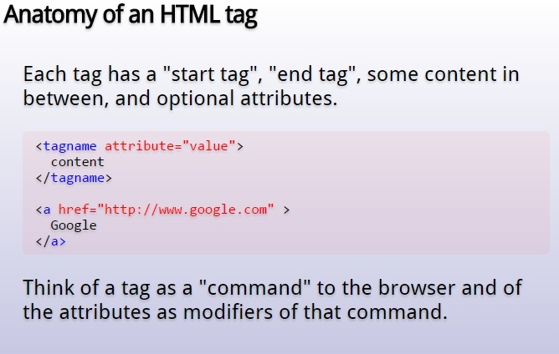

Slide 11
HTML Tags
All HTML tags are
made up of a tag name
Enclosed within < and > brackets.
Sometimes followed by an optional list of attributes which all appear between angle brackets < >
Attributes are properties that extend or refine the tag’s functions
Nothing within the brackets will be displayed by the browser
Notes:
11

Slide 12
Tags and attributes...
Attributes
<body bgcolor=“khaki” text=“#000000” >
Attributes are added within a tag to extend a tag’s action.
You can add multiple attributes within a single tag.
Attributes come after the tag name;
Each attribute should be separated by one or more spaces.
Most attributes take values, which follow an equal sign “=“ after the attribute’s name.

Slide 13
Standalone Tags
There are a few HTML tags which do not use an end tag and are used for standalone elements on the page:
<img> to display an image
<BR> Line break
<HR> horizontal line
Notes:
13

Slide 14
Nested Tags
Whenever you have HTML tags within other HTML tags, you must close the nearest tag first
Example:
<H1> <I> The Nation </I> </H1>

Slide 15
Comments
Browser will NOT display comment text
<!-- This is a comment -->
<!-- This is another
comment
-->

Slide 16
<!DOCTYPE> Declaration
The <!DOCTYPE> declaration is not an HTML tag
It is an instruction to the web browser about what version of HTML the page is written in.

Slide 17
Structure of a Web Page
All Web pages share a common structure
All Web pages should contain a pair of <HTML>, <HEAD>, <TITLE>, and <BODY> tags
<HTML>
<HEAD>
<TITLE> Example </TITLE>
</HEAD>
<BODY>
This is where you would include the text and images on your Web page.
</BODY>
</HTML>
Notes:
17

Slide 18
Creating HTML page
Write the HTML tags in a notepad and save the file as name.html
Now open the file in any browser to see the HTML page.

Slide 19
The <TITLE> Tag
Choose the title of your Web page carefully. The title of a Web page determines its ranking in certain search engines
The title will also appear on Favorite lists, History lists, and Bookmark lists to identify your page
<head> <title> My First Page </title> </head>
Notes:
19

Slide 20
Structural Tags
<HTML>
These tags enclose the entire Web page document.
</HTML>
<HEAD>
These tags enclose the Head part of the document
</HEAD>
<TITLE> These tags enclose the title of the document. This text appears in the title bar in the browser and on the bookmark list if someone bookmarks your web page.
</TITLE>

Slide 21
Sample Structure of a Web Site
<HTML>
<HEAD>
<TITLE> John Q. Public's Web Page </TITLE>
</HEAD>
<BODY>
This is John Public's Webpage!
</BODY>
</HTML>

Slide 22
Header Tags
Header Tags -- Used for marking sections and subsections in a document.
<H1>Header 1 -- Giant-sized and bold </H1>
<H2>Header 2 -- Large and bold </H2>
<H3>Header 3 -- Normal-sized and bold </H3>
<H4>Header 4 -- Small and bold </H4>
<H5>Header 5 -- Very Small and bold </H5>
<H6>Header 6 -- Tiny and bold </H6>

Slide 23
Header Tags (cont.)
H1 = Giant-sized and bold
H2 = Large and bold
H3 = Normal-sized and bold
H4 = Small and bold
H5 = Very Small and bold
H6 = Tiny and bold

Slide 24
Breaking Lines and Paragraphs
<P> text </P>
Paragraph tag
Most browsers render (process) this with blank lines between each paragraph
<BR>
Line break tag
Used when the webmaster wants a carriage return but doesn't want a blank line to follow
Example: text a
<p>text a</p>
<p>text b</p> text b
<br>text c
<br>text d text c
text d

Slide 25
Horizontal Rule
The <HR> tag puts a graphical line across the page.
Ex:
Horizontal Rule Attributes:
NOSHADE -- A solid line with no shading
WIDTH="xx%/xx" -- Controls the width of the line. You may specify either percentage of the width of a page or actual pixel length
SIZE="xx" -- Controls the height of the line. You need to specify the
dimension in pixels.
ALIGN="left/center/right" -- This allows the line to be aligned to the left,
right, or center of the page

Slide 26
Text Formatting Tags
Some basic text formatting styles:
Tag Result
<I> Italics </I> Italics
<B> Bold </B> Bold
<PRE> Preformatted Text </PRE> Preformatted Text
<STRONG> Strong </STRONG> Strong
<ADDRESS> Address </ADDRESS> Address
<CITE> Citations </CITE> Citations
<CODE> Source Code </CODE> Source Code

Slide 27
Font modifications
Web creators can also change the way text looks by using the <FONT> tag
SIZE="number" - changes size of the font; 1=smallest, 7 = largest <FONT SIZE="7">Big</FONT> <FONT SIZE="1">Small</FONT>
Big Small
COLOR="color-name" - changes text color
<FONT COLOR="red">This is red</FONT>
This is red
FACE="font-name" - changes font
<FONT FACE="verdana">This is the verdana font;</FONT> <FONT FACE="chicago">this is the chicago font.</FONT>
This is the verdana font; this is chicago font.

Slide 28
<Font> modifications (cont.)
One can combine font modifications:
<FONT SIZE="7" FACE="courier" COLOR="red">Big, Courier & Red</FONT>
Big, Courier & Red
<FONT SIZE="7"><FONT FACE="courier">Big & Courier</FONT> - Just Big</FONT>
Big & Courier - Just Big

Slide 29
Lists -- Unordered Lists
Unordered lists:
<UL>
<LI>Item One
<LI>Item Two
<LI>Item Three
<LI>Item Four
</UL>
Item One
Item Two
Item Three
Item Four
Unordered List Attributes:
type="disc/circle/square"
Disc (default) ○ Circle  Square

Slide 30
Lists -- Ordered Lists
Ordered (Numbered) Lists:
Ordered List Attributes:
<OL>
<LI> Item One
<LI> Item Two
<LI> Item Three
<LI> Item Four
</OL>
1. Item One
2. Item Two
3. Item Three
4. Item Four
type="i/I/a/A/1" (default)
i = i. Item One I = I. Item One a = a. Item One A = A. Item One 1 = 1.Item One
ii. Item Two II. Item Two b. Item Two B. Item Two 2. Item Two
iii. Item Three III. Item Three c. Item Three C. Item Three 3. Item Three
iv. Item Four IV. Item Four d. Item Four D. Item Four 4. Item Four
start="xx"
This attribute lets you specify which number/letter will start the list

Slide 31
Lists -- Definition Lists
Definition Lists:
<DL>
<DT>List Name One
<DD>This is where information about List Name One would go</DD>
</DT>
<DT>List Name Two
<DD>This is where information about List Name Two would go</DD>
</DT>
</DL>
List Name One
This is where information about List Name One would go
List Name Two
This is where information about List Name Two would go

Slide 32
Links
The anchor tag <A> is used to link one document to another or from one part of a document to another part of the same document.
Basic Links:
<A HREF="http://www.stanford.edu/">Stanford University</A>
Inter-document Links:
<A HREF="#spot">Point to 'spot' in this document</A>
Defining a point in a document:
<A NAME="spot">Spot</A>
Email links:
<A HREF="mailto:someone@somehost.com">Email someone@somehost.com</A>

Slide 33
Graphics
To have a graphic appear on a webpage, web designers must to put the <IMG> tag in with the address where the graphic "lives":
<IMG SRC="http://www.someplace.com/images/fish.gif">
Graphics attributes:
alt="text": insert a description of the graphic for those who are using browsers that cannot process images (e.g., page readers for the blind)
width="xx/xx%": width in pixels/percentage
height="xx/xx%": height in pixels/percentage
border="xx": pixel length of the border surrounding the image.
hspace="xx": places a buffer of space horizontally around the image
vspace="xx": places a buffer of space vertically around the image
align="top/middle/bottom/right/left": aligns image in relation to the text (see next 2 slides)

Slide 34
Graphics (cont.)
<img src="http://www.someplace.com/images/fish.gif" align="top">All about Fish
<img src="http://www.someplace.com/images/fish.gif" align="middle">All about Fish
<img src="http://www.someplace.com/images/fish.gif" align="bottom">All about Fish
All about Fish
All about Fish
All about Fish

Slide 35
Graphics (cont.)
<img src="http://www.someplace.com/images/fish.gif" align="left">
<img src="http://www.someplace.com/images/fish.gif" align="right">

Slide 36
Text Formatting Tags
<U> Underline </U>
<b>..</b>: Defines bold text
<big>..</big>: Defines big text
<em>..</em: Defines emphasized text
<i>..</i>: Defines italic text
<small>..</small>: Defines small text
<strong>..</strong>: Defines strong text
<sub>..</sub>: Defines subscripted text
<sup>..</sup>: Defines superscripted text
<strike>..</strike>: defines strike tag
<center> ..</center>: indicates a section that is center aligned.
<left> ..</left>: indicates a section that is left aligned.

Slide 37
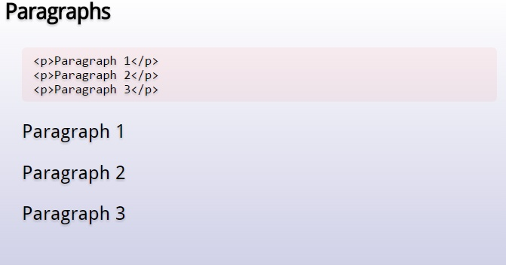

Slide 38
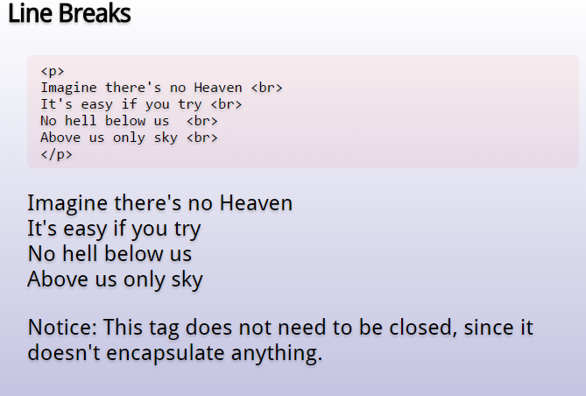

Slide 39
Changing the Font
<FONT FACE = “fontname”> … </FONT>
It can be used to change the font of the enclosed text
`
<FONT SIZE=n> …. </FONT>
where n is a number between 1 and 7
It can change the size of text use the expression

Slide 40
Changing the Font
<FONT COLOR=“red”>…. </FONT>
It can change the color. The color can also be defined using hexadecimal representation ( Example: #ffffff )
These attributes can be combined to change the font, size, and color of the text all at once;
For example,
<FONT SIZE=4 FACE=“Courier” COLOR=“red”> …. </FONT>

Slide 41
<Font>…</Font>
The <font> tag is not supported in HTML5.

Slide 42
Headings
Web pages are typically organized into sections with headings
To create a heading use the expression <Hn>….</Hn> where n is a number between 1 and 7
In this case, the 1 corresponds to the largest size heading while the 7 corresponds to the smallest size

Slide 43
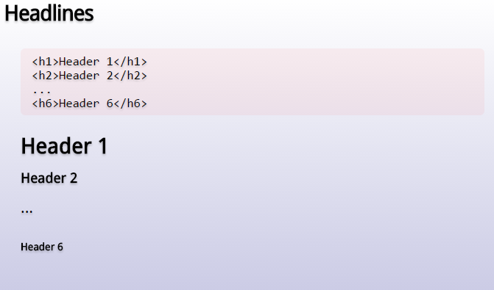

Slide 44
Aligning Text
The ALIGN attribute can be inserted in the <P> and <Hn> tags to right justify, center, or left justify the text
For example,
<H1 ALIGN=CENTER> The New York Times </H1>
It would create a centered heading of the largest size

Slide 45
Page Formatting
To define the background color, use the BGCOLOR attribute in the <BODY> tag
To define the text color, use the TEXT attribute in the <BODY> tag
To define the size of the text, type <BASEFONT SIZE=n>

Slide 46
Example
<HTML>
<HEAD>
<TITLE> Example </TITLE>
</HEAD>
<BODY BGCOLOR=“black” TEXT=“white”>
<BASEFONT SIZE=7>
This is where you would include the text and images on your Web page.
</BODY>
</HTML>

Slide 47
Attributes of <BODY> Tag
bgcolor color Specifies the background color of a document
text color Specifies the color of the text in a document
background URL Specifies a background image for a document
alink color Specifies the color of an active link in a document
link color Specifies the color of unvisited links in a Doc
vlink color Specifies the color of visited links in a document

Slide 48
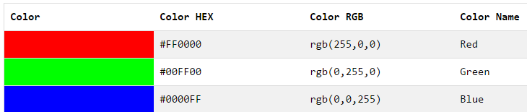
Different ways of specifying color
Notes:
48

